Slide 1

Dan Gottlieb, Central Square Solutions, LLC (@GotDan)
Josh Mandel, Microsoft (@JoshCMandel)
Revised October 2022
FHIR BULK DATA API
Extending FHIR to Population Level Datasets

Slide 2
Agenda
slides: https://bit.ly/fhir-bulk-api
Why a FHIR Bulk Data API?
Technical Architecture & what’s new in 2.0
Open Source Tools
Adoption!
Next steps and how to get involved

Slide 3



FHIR APIs
FHIR REST API FHIR Bulk Data API
Patient Panel Population

Slide 4
Use Cases
Internal clinical data warehouse for study cohort identification
Claims in EHR to provide comprehensive view
Machine learning startup obtaining training data from cloud EHR
Integration population health system with EHR system
Transferring records from one EHR to another
Payer database to assess care quality
Reportable disease submission or other registry

Slide 5

Let’s enhance to support population level data access
FHIR Resources as a standard data model to simplify data parsing and mapping
FHIR Operation API to initiate the data extracts
SMART Backend Services Authorization as security model

Slide 6
Focused Scope + Complementary Technologies
Legal framework for sharing data between partners needs to be set up out-of-band (BAAs, SLAs, DUAs)
Real-time data - data loaded through bulk APIs can be supplemented with real time FHIR REST API calls or subscriptions
Patient matching - it’s possible to include identifiers like subscriber number in Bulk Export FHIR resources
Data transformation - can serve as a foundation for data pipeline

Slide 7
Technical Architecture
Bulk Data Access Implementation Guide

Slide 8
Bulk Data Access IG Versions
STU1 (v1) Initial version Published August 2019 | STU2 (v2) Incorporates experience from early implementations Published November 2022

Slide 9
Kick-off Request
Bulk Data
Client
(destination)
Kick-off Request
Bulk Data
Server
(source)

Slide 10
Kick-off Request
Updated in v2
Asynchronous requests with status polling (HTTP GET only in v1, GET or POST in v2)
Prefer: respond-async
FHIR Operation for all data on all patients (all data in the patient “compartment”)
[FHIR Server Base]/Patient/$export
FHIR Operation for all data on a group of patients (eg. research cohort, plan members)
[FHIR Server Base]/Group/[group id]/$export
FHIR Operation for all data on the server
[FHIR Server Base]/$export

Slide 11
Kick-off Operation Parameters
_outputFormat | The format for the generated bulk data files Currently, only ndjson is supported
_since | Filter results by FHIR resource modified date FHIR instant timestamp (required for servers to support)
_type | Filter results by comma delimited list of FHIR resource types (optional for servers to support)
_typeFilter | Filter using FHIR REST queries (optional and experimental)
Updated in v2

Slide 12
Kick-off Operation Parameters
New in v2
_elements | FHIR resource elements to return e.g., Patient.id, Patient.identifier (optional and experimental)
Patient | FHIR Patient References to limit data returned (optional, not valid for GET requests or system level requests)
includeAssociatedData | Metadata resources to include with response e.g., LatestProvenanceResources or RelevantProvenanceResources (optional and experimental)

Slide 13
Kick-off Response
Bulk Data
Client
(destination)
Kickoff Request
Bulk Data
Server
(source)
Content Location

Slide 14
Kick-off Response Header
Status: 202 Accepted
Content-Location: [URL for status or deleting request]

Slide 15
Status Request #1
Bulk Data
Client
(destination)
Kickoff Request
Bulk Data
Server
(source)
Content Location
GET Content Location

Slide 16
Status Response #1
Bulk Data
Client
(destination)
Kickoff Request
Bulk Data
Server
(source)
Content Location
GET Content Location
File Generation Status

Slide 17
In-Progress Status Response Header
Status: 202 Accepted
X-Progress: “50% complete”
Retry-After: 120

Slide 18
Status Request #2
Bulk Data
Client
(destination)
Kickoff Request
Bulk Data
Server
(source)
Content Location
GET Content Location
File Generation Status
GET Content Location

Slide 19
Status Response #2
Bulk Data
Client
(destination)
Kickoff Request
Bulk Data
Server
(source)
Content Location
GET Content Location
File Generation Status
GET Content Location
JSON manifest

Slide 20
Status Complete Response Body
"transactionTime" : "2020-07-13T13:28:17.239Z", "request" : "https://example.com/Patient/$export?_type=Patient,Observation", "requiresAccessToken" : true, "output" : [{ "type" : "Patient", "url" : "https://example.com/files/patient_file_1.ndjson" },{ "type" : "Patient", "url" : "https://example.com/files/patient_file_2.ndjson" },{ "type" : "Observation", "url" : "https://example.com/filesw/observation_file_1.ndjson" }],
"deleted" : [{
"type" : "Bundle",
"url" : "https://example.com/output/del_file_1.ndjson"
}],
"error" : [{ "type" : "OperationOutcome", "url" : "https://example.com/files/error_file_1.ndjson" }]
1
2
3
4
5
6
New in v2
Updated in v2

Slide 21
File Request
Bulk Data
Client
(destination)
Kickoff Request
Bulk Data
Server
(source)
Content Location
GET Content Location
File Generation Status
GET Content Location
JSON manifest
GET File (eg. 0001.Observation.ndjson)

Slide 22
File Response
Bulk Data
Client
(destination)
Kickoff Request
Bulk Data
Server
(source)
Content Location
GET Content Location
File Generation Status
GET Content Location
JSON manifest
GET File (eg. 0001.Observation.ndjson)
FHIR Resources File

Slide 23
FHIR Resources
Data models representing discrete clinical and administrative units (patient, practitioner, allergy, medication order, etc.)
Currently around 100 have been defined
Can reference other resources by their URL
Don’t include the kitchen sink, but support extensions
“We only include data elements if we are confident that most normal implementations using that resource will make use of the element”
– Grahame Grieve (FHIR Product Director)
MU3 Common Clinical Dataset (and soon USCDI) defines subset

Slide 24
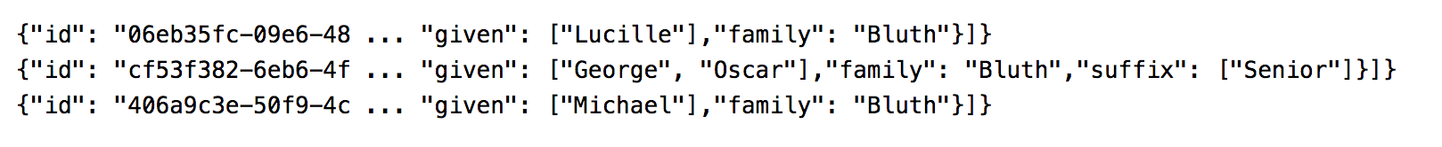
NDJSON
[
,
,
]

Slide 25
SMART Backend Services Authorization
Out-of-band app registration (can use Dynamic Client Registration or portal)
Apps can register public key (JWKS format) or URL for public key
Token requests signed with private key
System level scope (parallels SMART “user” and “patient” scopes)
system/[resourceType].read
Short-lived access tokens

Slide 26
Registration Flow (once)
Backend Service Admin
Configure Public Key and other OAuth settings
Bulk
Data
Server
OAuth Client Id

Slide 27
Authorization Flow (min. once per request)
Backend Service Admin
Configure Public Key and other OAuth settings
Bulk
Data
Server
OAuth Client Id
Bulk Data Client
Signed Token Request
Short Lived Access Token

Slide 28
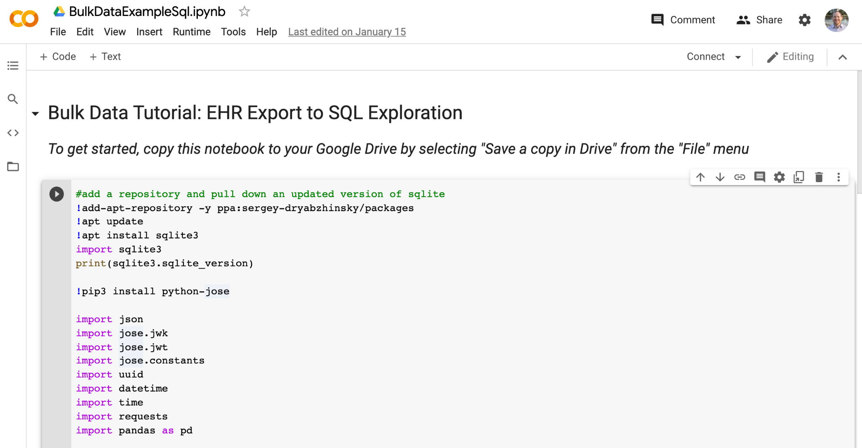
Tutorial (Python): EHR Export to SQL Exploration
https://colab.research.google.com/drive/1HhEEB3MJ8LbMP2ta946s8OARPc5RflHu

Slide 29
Enhancements
in v2

Slide 30
Historical Group Data
Server side with revised guidance on the “_since” parameter
“In the case of a Group level export, servers MAY return additional resources modified prior to the supplied time if the resources belong to the patient compartment of a patient added to the Group after the supplied time (this behavior should be clearly documented by the server).”
Client side with the “patients” and “_elements” parameters
Make a request to get just the ids of patients in the group with “_elements”
Use the “patients” parameter to get data for patients not previously retrieved
Use the “patients” paramter and the “_since” parameter to get new data for remaining patients
Updated in v2
New in v2

Slide 31
Attachments
New in v2
Resource elements of type Attachment must contain:
data element with a Base64 encoded version of the file
OR
url element with an absolute URL for the file accessible using the same authentication as the ndjson files

Slide 32
Open Source Tools

Slide 33
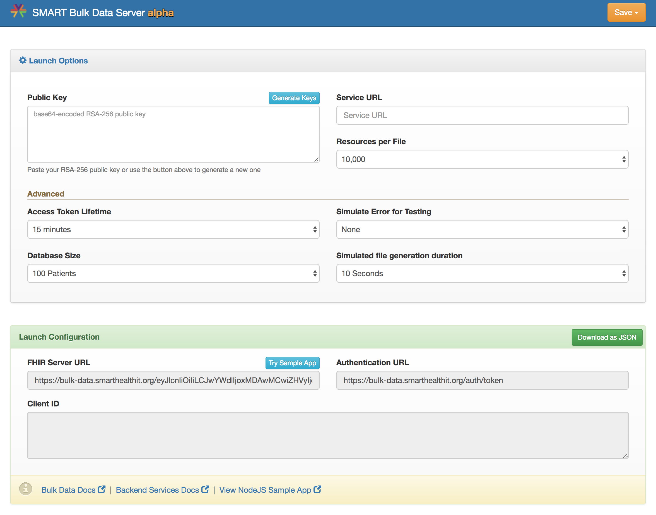
SMART Reference Server Implementation https://bulk-data.smarthealthit.org

Slide 34
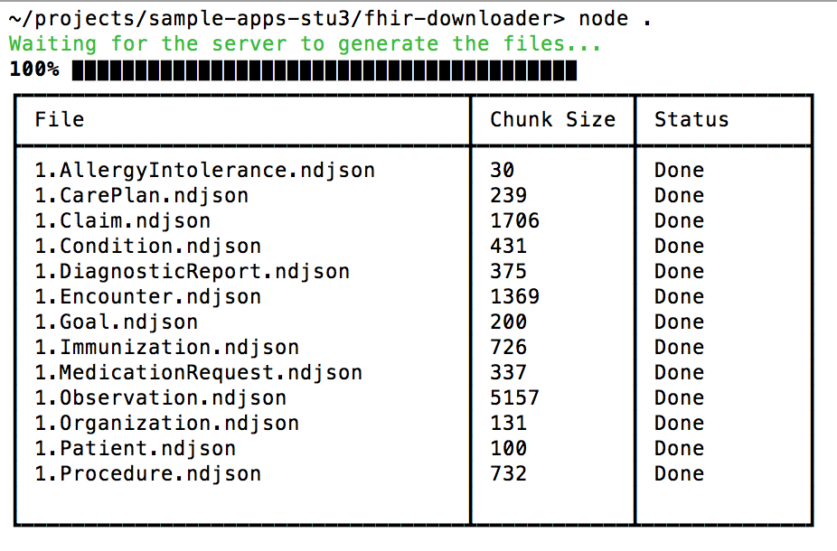
SMART Sample Client
https://github.com/smart-on-fhir/sample-apps-stu3/tree/master/fhir-downloader

Slide 35
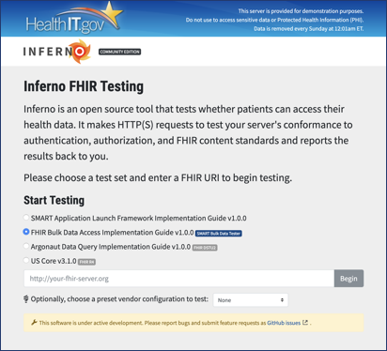
ONC Inferno Testing Tool
https://inferno.healthit.gov/community

Slide 36
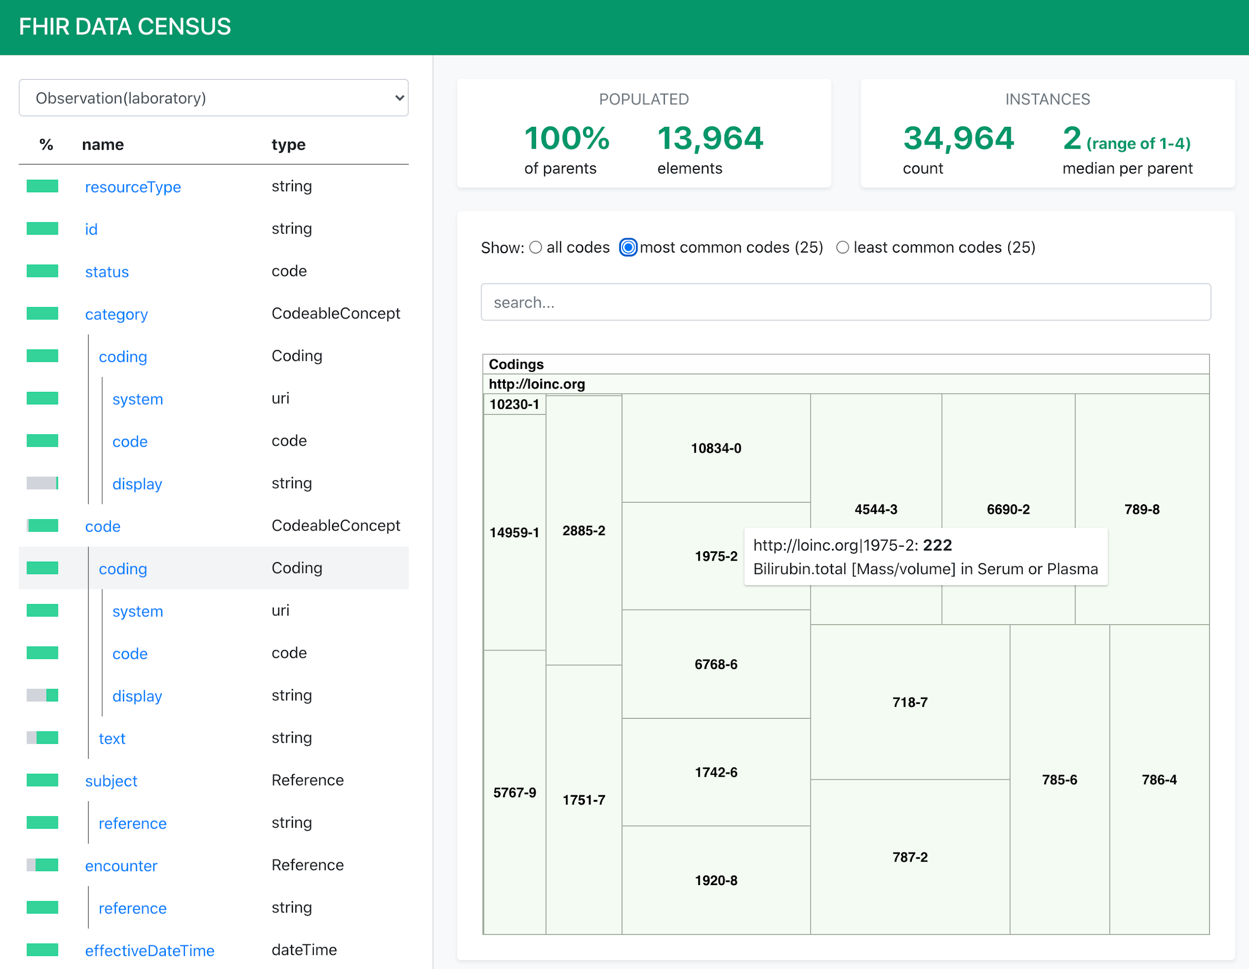
FHIR Data Census Tool https://github.com/sync-for-science/data-census

Slide 37
Adoption

Slide 38
Growing number of implementations!
Open Source FHIR Servers
Microsoft
HAPI
IBM
Commercial FHIR Servers
Azure API for FHIR
CareEvolution
Firely Server (SQL endpoint)
Google Healthcare API (in preview)
EHRs
Epic
Cerner
Allscripts, Athena Health, and many more!
Payor Data Servers
CMS ACO Beneficiary Claims Data (pilot)
CMS Data at the Point of Care (pilot)
CMS Claims to Part D Sponsors (pilot)

Slide 39
US Regulatory Requirements
170.215 [EHR Certification] Application Programming Interface Standards.
The Secretary adopts the following application programming interface (API) standards and associated implementation specifications […] FHIR Bulk Data Access (Flat FHIR) (v1.0.0: STU 1), including mandatory support for the “group-export” “OperationDefinition”
Implementation Date: 12/31/2022
Notes:
Standards version advancement process

Slide 40
Next Steps

Slide 41
Get Involved!
Use the APIs in real-world use cases and collect ideas for v3
Open source modules (eg. de-identification, filtering, NLP)
Define Bulk Import Operation (updates coming soon!)
Early draft proposals at https://github.com/smart-on-fhir/bulk-import/blob/master/import-pnp.md
Standardize analytic approaches (identify cohorts, quality measures)

Slide 42
Resources
slides: https://bit.ly/fhir-bulk-api
Bulk Data Implementation Guide
STU2 (v2): https://hl7.org/fhir/uv/bulkdata/
STU1 (v1): http://hl7.org/fhir/uv/bulkdata/
SMART Server Reference Implementation
https://bulk-data.smarthealthit.org
Bulk Data Discussion Group (Bulk Data Stream on FHIR Zulip Chat)
https://chat.fhir.org/#narrow/stream/bulk.20data

